Slide 1


Slide 2
MATERI
GREETING AND INTRODUCTION
THINGS AROUND US (SINGULAR AND PLURAL NOUN)
PEOPLE APPEARANCE
DAYS, DATES, AND TIME

Slide 3
GREETING AND INTRODUCTION
Situation | Greeting | Responses
Formal | Good morning Good afternoon Good evening Good day Good night How are you | Good morning Good afternoon Good evening Good day Good night I’m fine, thank you Fine, thanks
Informal | Hi, Desi Hello, Okta How are things? | Hi, Luki Hello, Dania Very well I’m OK Not too bad

Slide 4
Let’s Practice

Slide 5
THINGS AROUND US

Slide 6
THINGS AROUND US

Slide 7
THINGS AROUND US

Slide 8
THINGS AROUND US

Slide 12
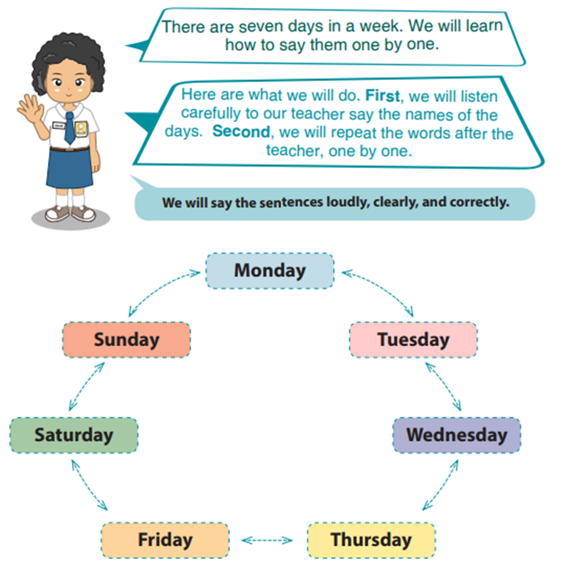
DAYS, DATES, AND TIME

Slide 13
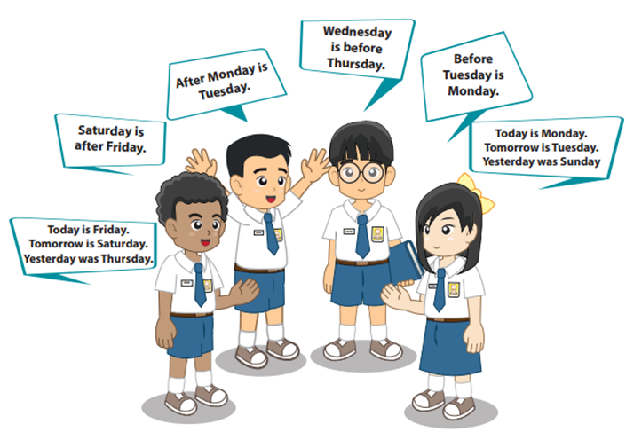

Slide 15
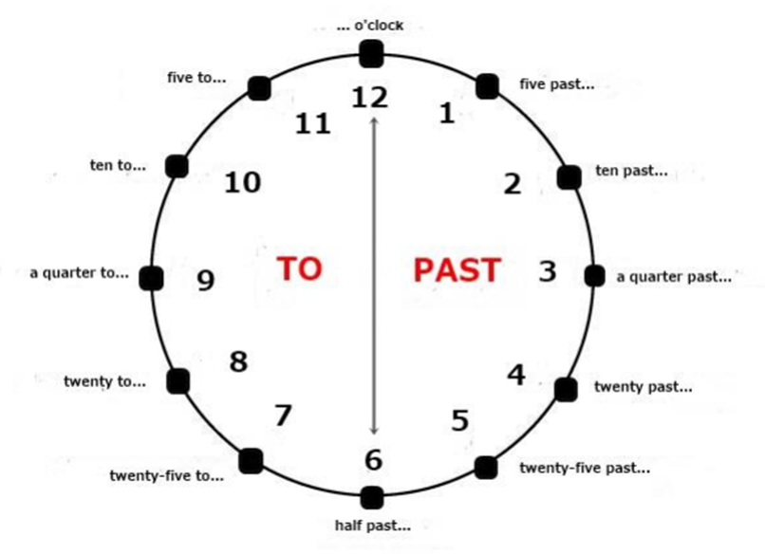
TELLING THE TIME

Slide 16
